Slide 1


Be Energies
Prepared By
G.M.Farid Hossain

Slide 2
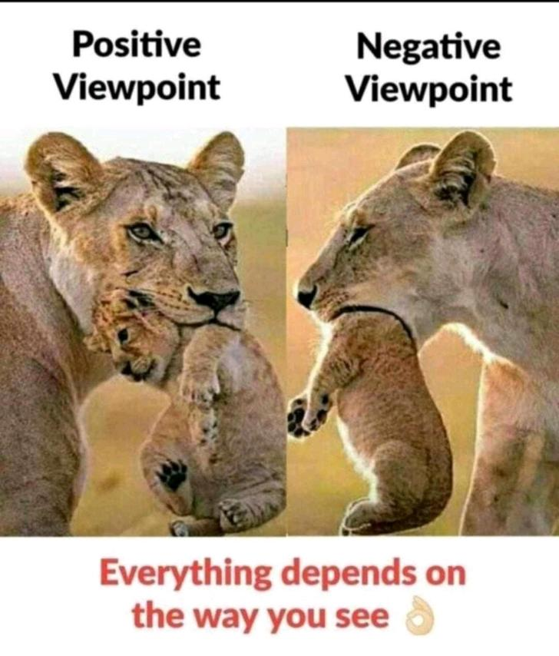
Perception
“Humans see what they want to see.”

Slide 3

Truth & Rumor
“The truth never lies.”

Slide 4

Success & Teamwork
Success
Teamwork
Motivation

Slide 5
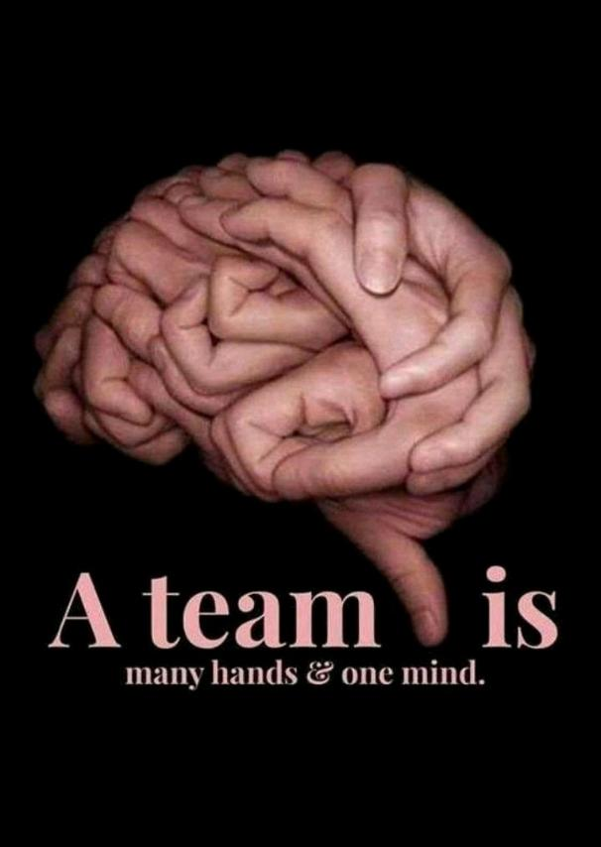
Teamwork
"Talent wins games, but teamwork & intelligence win championships."

Slide 6

Attitudes
“Fairy tales are more than true: not because they tell us that dragons exist, but because they tell us that dragons can be beaten.”

Slide 7
Thank You

